Slide 1

Department of Computer Science & Engineering
BIOMETRIC STEGANOGRAPHY USING MID POSITION VALUE TECHNIQUE
Date: 27 May 2021
BADAVATH KAVERI : 17WH1A0502
N UMA MAHESWARI : 17WH1A0527
V SATYA KRISHNA : 17WH1A0544
Internal Guide: Ms. C JAGADEESWARI
Designation: Assistant Professor
BVRIT HYDERABAD College of Engineering for Women

Slide 2

Why Should I Study this course?
ABSTRACT
Problem Statement:
The use of an individual’s biometric characteristics to advance authentication and verification technology beyond the current dependence on passwords has been the subject of extensive research for some time. Since such physical characteristics cannot be hidden from the public eye, the security of digitized biometric data becomes paramount to avoid the risk of substitution or replay attacks.
Project Objective:
To present a steganographic approach of concealing the secret data so as to facilitate secure communication. Arnold transformation will be imposed on the chosen secret image in the first stage. This results in the scrambling of the data bits, thereby disrupting the normal pixel orientation. Thereafter, data bits from the scrambled secret image are embedded within the cover. Henceforth the stego is generated.
Examples
BVRIT HYDERABAD College of Engineering for Women

Slide 3
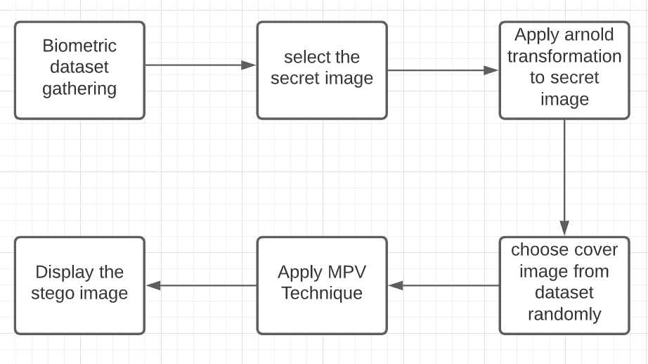
Design
Encoding:

Slide 4
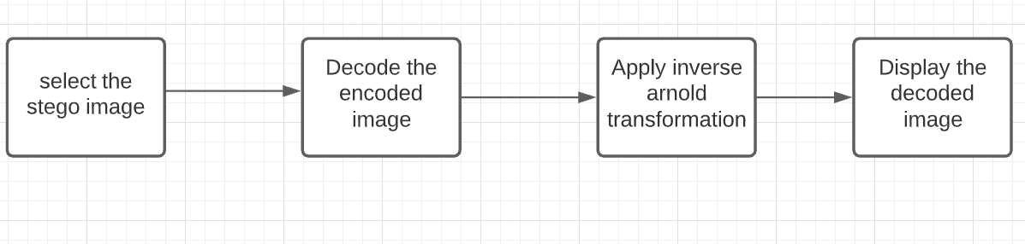
Design
Decoding :

Slide 5
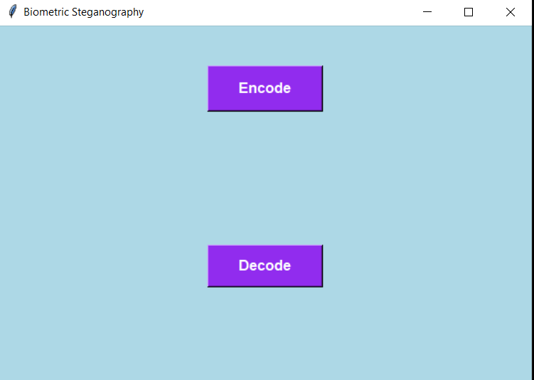
Why Should I Study this course?
OUTPUT - Encoding
Examples
BVRIT HYDERABAD College of Engineering for Women

Slide 6
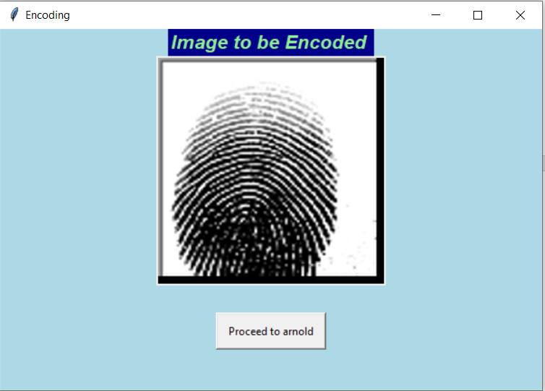
Why Should I Study this course?
OUTPUT
Examples
BVRIT HYDERABAD College of Engineering for Women

Slide 7
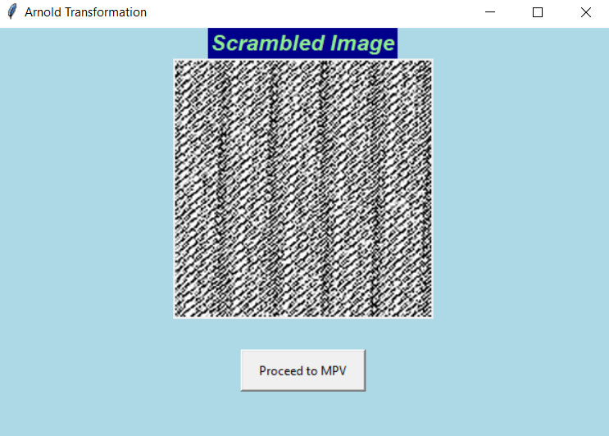
Why Should I Study this course?
OUTPUT
Examples
BVRIT HYDERABAD College of Engineering for Women

Slide 8
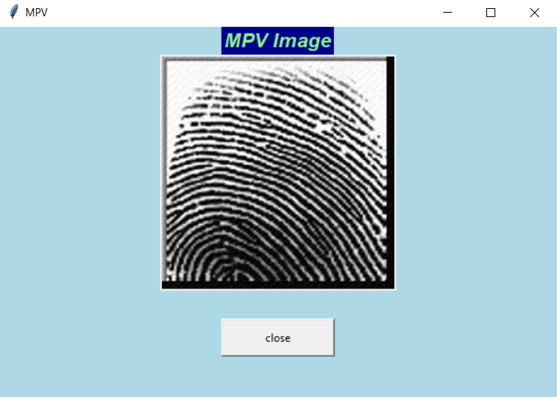
Why Should I Study this course?
OUTPUT
Examples
BVRIT HYDERABAD College of Engineering for Women

Slide 9
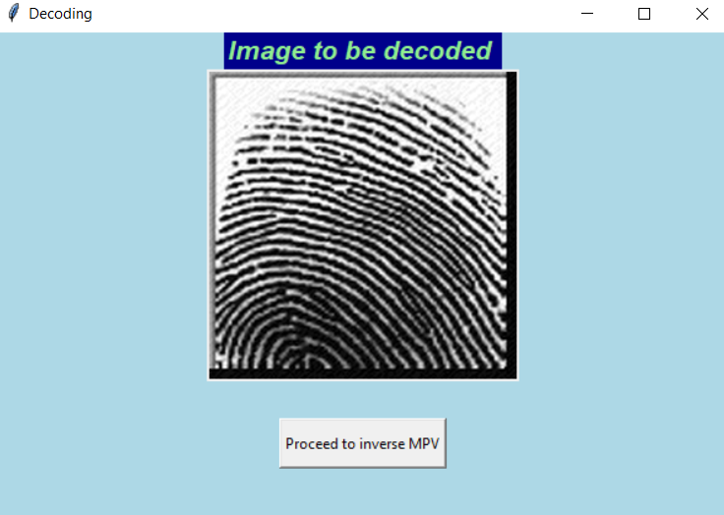
Why Should I Study this course?
OUTPUT - Decoding
Examples
BVRIT HYDERABAD College of Engineering for Women

Slide 10
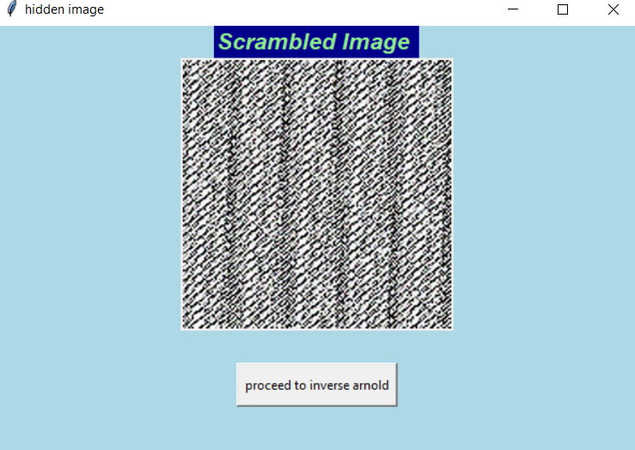
Why Should I Study this course?
OUTPUT
Examples
BVRIT HYDERABAD College of Engineering for Women

Slide 11
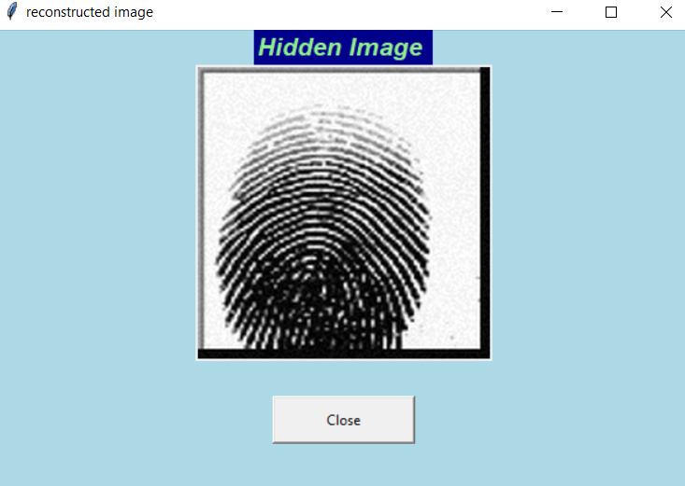
Why Should I Study this course?
OUTPUT
Examples
BVRIT HYDERABAD College of Engineering for Women

Slide 12
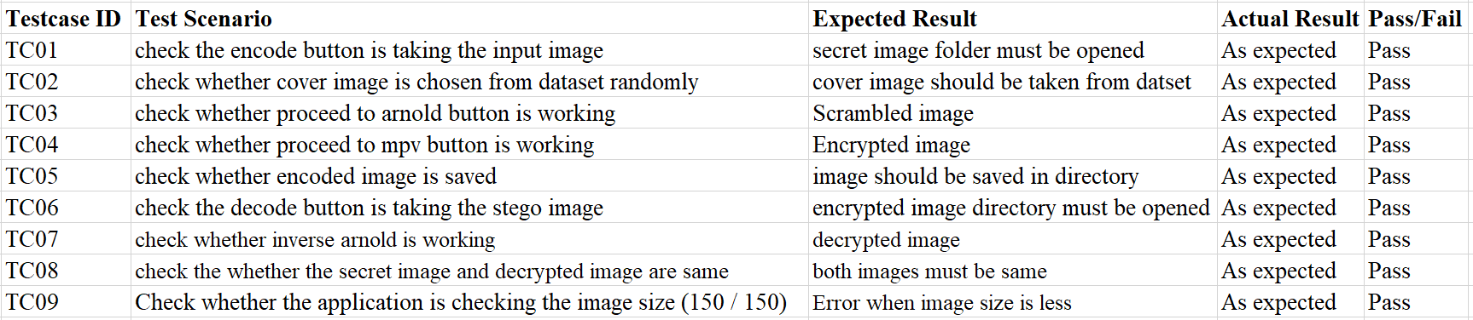
Why Should I Study this course?
TESTCASES
Examples
BVRIT HYDERABAD College of Engineering for Women

Slide 13
REFERENCES
[1]https://www.researchgate.net/publication/333559334_Integration_of_Biometrics_and_Steganography_A_Comprehensive_Review
[2]https://www.researchgate.net/publication/325657541_Image_Steganography_Using_Mid_Position_Value_Technique
[3]https://www.academia.edu/10228724/FINGERPRINT_BASED_IMAGE_STEGANOGRAPHY_IN_TRANSFORM_DOMAIN
[4]http://www.ijstr.org/final-print/dec2019/-Image-Steganography-Using-Lsb.pdf
BVRIT HYDERABAD College of Engineering for Women

Slide 14
Thankyou
BVRIT HYDERABAD College of Engineering for Women

